Slide 1

Welcome to the Year 6 Arithmetic Methods Session

Slide 2
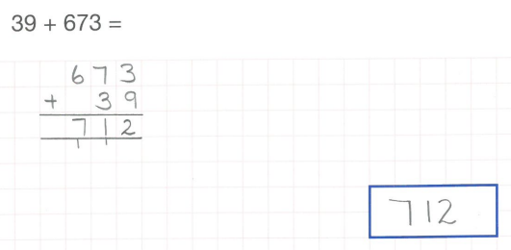
Addition of whole numbers -Column Method
Q1

Slide 3
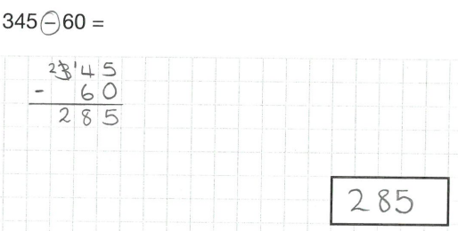
Subtraction of whole numbers -Column Method
Q2

Slide 4
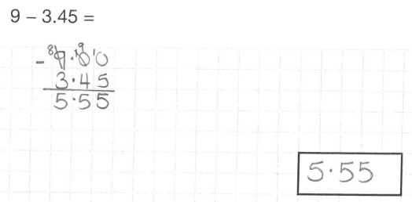
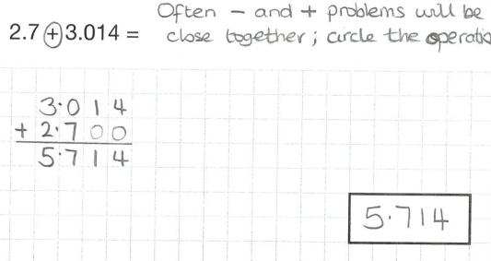
Addition and subtraction of decimal numbers - Column Method
Q2&3

Slide 5
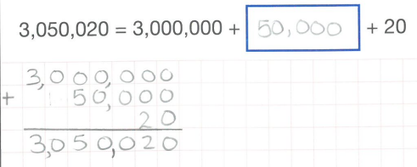
Understanding the place value within addition (partitioning)
Q5

Slide 6
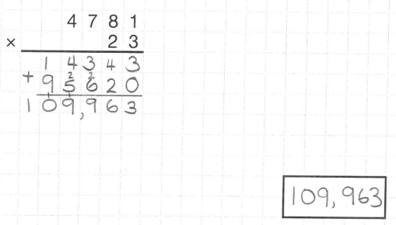
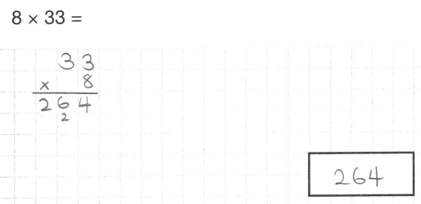
Multiplication of two numbers - long multiplication method
Q6

Slide 7
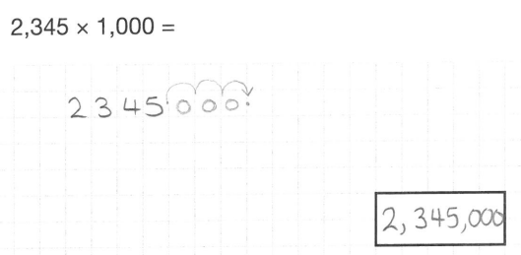
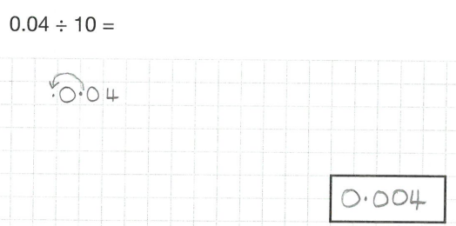
Multiplying and dividing by 10, 100 and 1000 -movement of digits
Q7 & 8

Slide 8
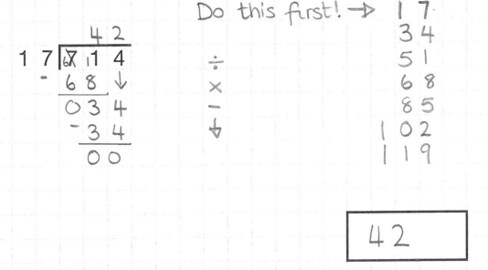
Division of a number by a 2-digit number - long division
Q11

Slide 9
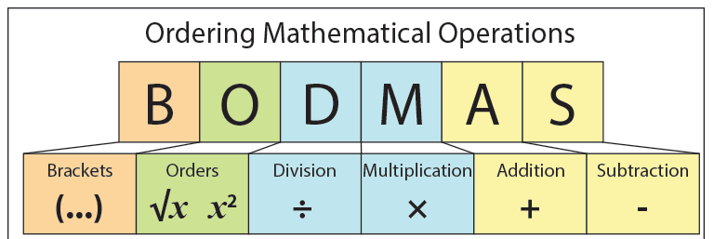
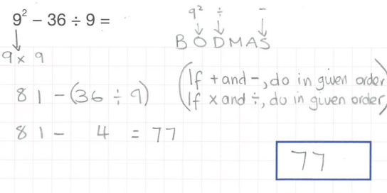
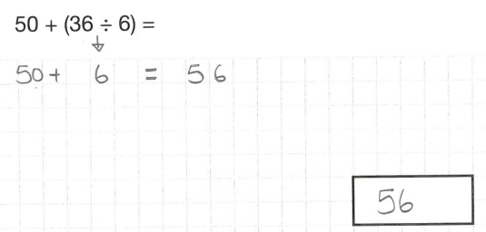
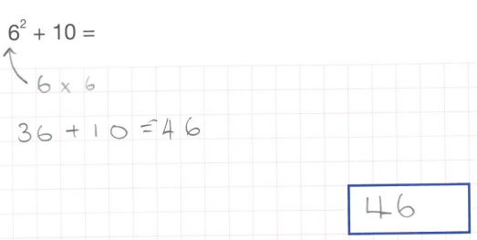
Q12

Slide 10
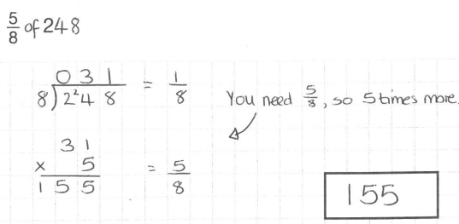
Find a fraction of a quantity
Q14

Slide 11
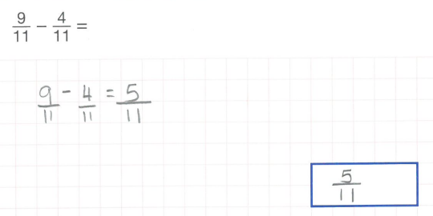
Add and subtract fractions with the same denominator
Q15 & 16

Slide 12
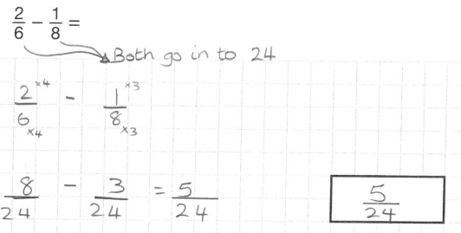
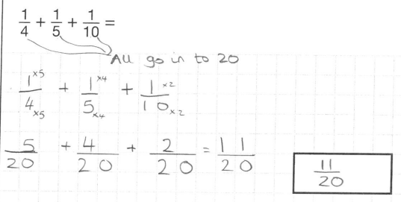
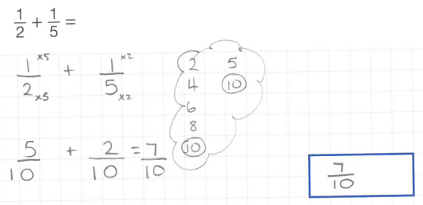
Add and subtract fractions with different denominators
Q17 & 18

Slide 13
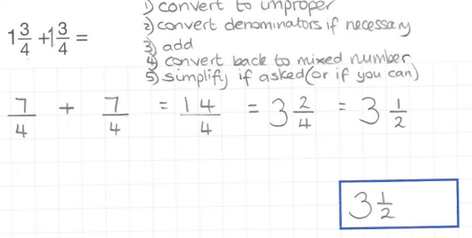
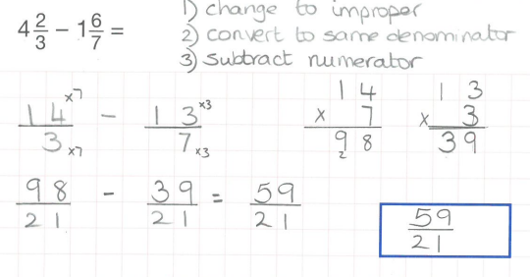
Add and subtract mixed number fractions
Q19 & 20

Slide 14
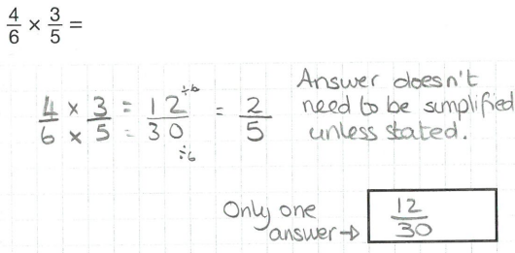
Multiply fractions
Multiply the numerator and the denominator
Q21

Slide 15

Multiply a fraction by an integer
Q23

Slide 16
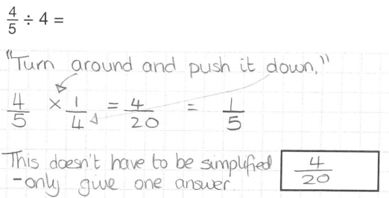
Divide a fraction by an integer
Q24

