Slide 1
Year 6 Curriculum Information 2022-2023

Slide 2
The Year 6 Team
Mrs Khaira (6K Class Teacher)
Miss Tresadern (6T Class Teacher)
Year 6 Support
Mrs Stopps
Mrs Higgins
Mrs Hussain
We also have weekly volunteer readers

Slide 3

Content of the Year 6 Curriculum
Linked to the requirements of the 2014 National Curriculum, in Year 6, the children will continue to access all areas of the curriculum, but there will be a greater focus on their acquisition of English and Maths skills and their use and application of these in all other areas of the curriculum.

Slide 4
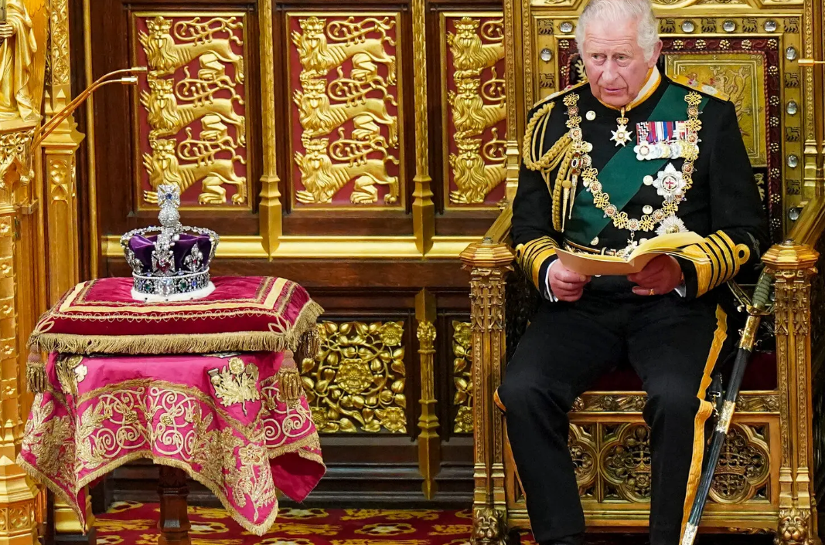
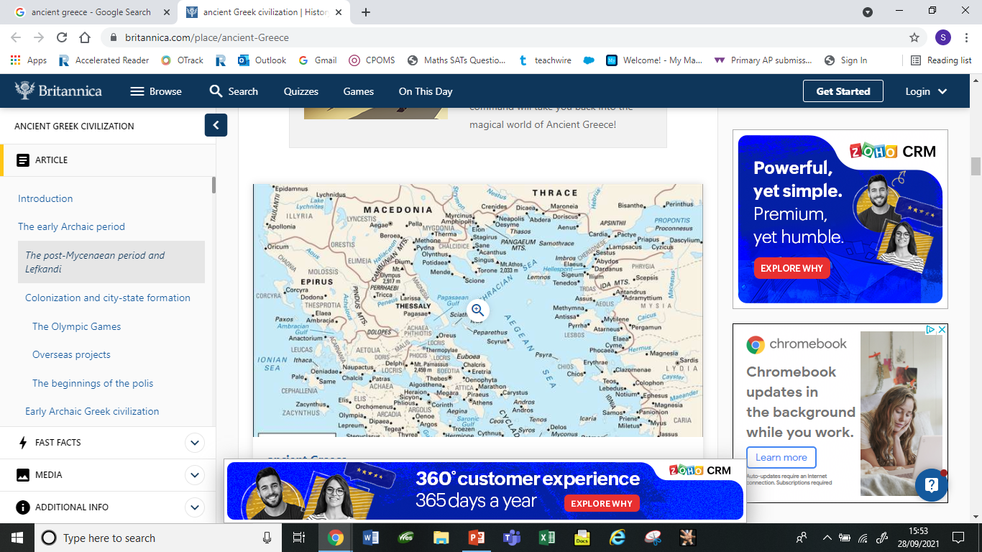
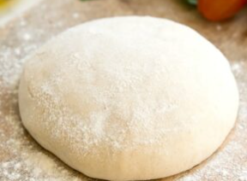
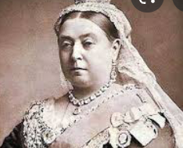
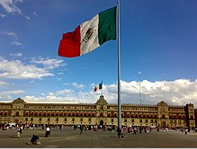
Year 6 Topics
Autumn Term |  | Spring Term |  | Summer Term
First half | Second half | First half | Second half | First half | Second half
Dough | Victorians | Monarchs | Mexico | Greece | Moving On

Slide 5

Accelerated Reader
AR supports independent school and home reading:
The children complete a termly Star Reading test (Year 6 children have already taken their first one)
This gives the children a ZPD – zone of proximal development
Each child selects their individual reading book according to their AR score (school books are colour coded to enable children to choose their book independently)
Quizzes – once the children have read the book, they complete a short quiz about the book which enables us to know if they have read with understanding; a pass consists of 8/10 questions or higher

Slide 6


Reading
All children have a reading book (linked to the Accelerated Reader Programme) which they are encouraged to take home daily and read for at least 15 minutes.
We, as a school, foster a love of reading and in addition to Accelerated Reader and guided reading sessions, we have timetabled opportunities to read for pleasure (DEAR) when children can read any book that interests them which may be separate to AR books.
We have been working on whole class reading which involves studying a text in more detail.

Slide 7
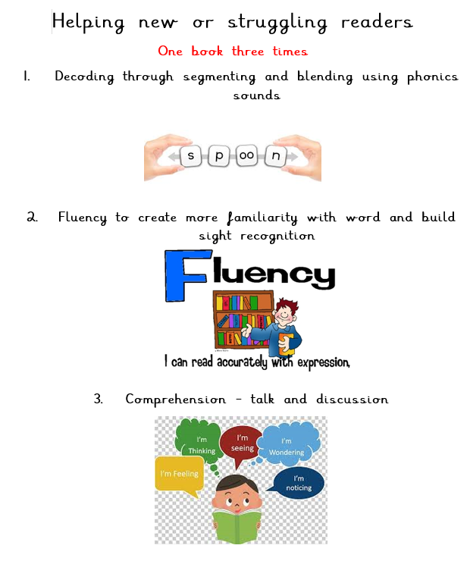

Slide 8
Writing
Writing is linked to a topic and involves texts related to this. For example, our topic theme is Dough, therefore our texts are Lunch Money, The Money Pit Mystery and The Story of Money.
Throughout the year, there will be continued practice in the different genres including: narrative, poetry and non-fiction.
Cross curricular writing links are identified and used in all areas of the curriculum. For example, the children will be writing a diary entry in geography and instructions in DT.
All of the written work will be used to form an overall assessment at the end of Year 6 (there is no writing SATs test). This will moderated externally this year.

Slide 9
GPS
There will be regular sessions at school to develop the children’s knowledge, use and application of grammar, punctuation, vocabulary and spelling.
We use the CGP books to support the teaching and learning of GPS and for the children to consolidate this as part of their homework.
The children will be tested regularly on the Year 3/4 and 5/6 word list which could appear in the spelling SATs test. Copies of these words are in the back of all of the children’s homework books; they should practise them regularly (recording any words they know by dating them on the given sheet).

Slide 10
Maths
We have purchased Times Table Rock Stars which embeds the learning of the times table in a fun and interactive way!
This is progressive and is tailored to children's national attainment
Year 6 pupils all work on the 6 part lesson for daily maths lessons. This involves a fluency (arithmetic) section, followed by reasoning and then problem solving sections. This year, we have included a specific challenge section for children who prove all of these skills competently.
We will complete regular arithmetic practice assessments in school and go through the answers as a class to go over any misconceptions.
CGP books will be used as homework activities to consolidate the maths taught each week at school.

Slide 11
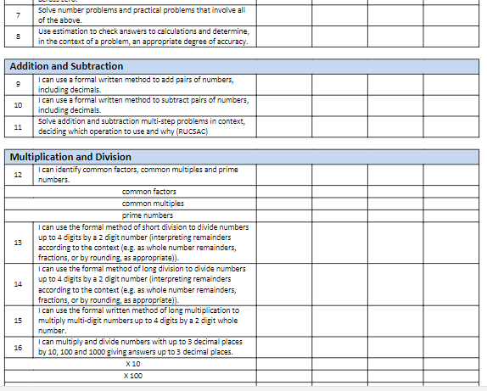
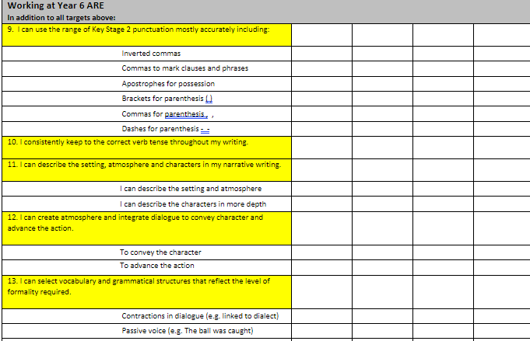
Examples of Year 6 Maths and Writing Targets

Slide 12
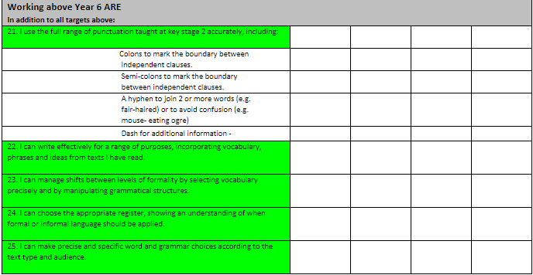
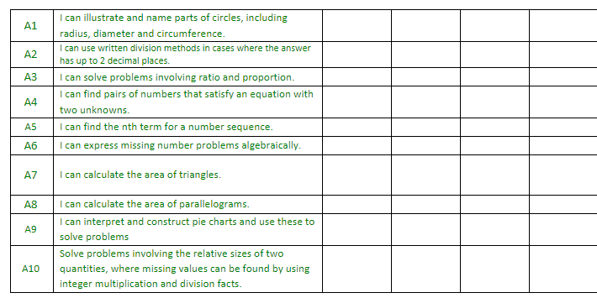
Exceeding Expectation Targets…
If your child is achieving above age related expectations for Year 6 (ARE), the exceeding Year 6 AWOL targets for writing and maths encourage more in-depth and investigative work; allowing a greater mastery and understanding of concepts and ideas.

Slide 13
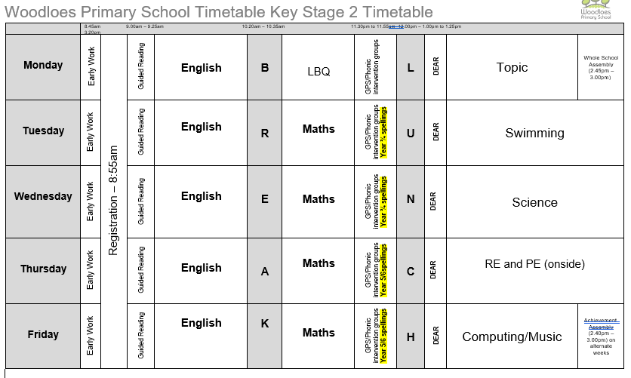
Year 6 Weekly Timetable
Homework due in
Homework given in

Slide 14
PE/Games
Autumn Term P.E./Games | Year 6
This will change in the Spring term when we will no longer be swimming and Year 6 have onside coaching on Thursdays. | Tuesday | Thursday
 | Swimming | Team games
Children are to bring their swimming kit to school every Tuesday and their PE kit in a separate bag on a Thursday.
Children who are attending clubs (dance/judo/tennis) must also bring their PE kit to change into on that day. They will be given time before and after to change.

Slide 15
Homework
Weekly English and Maths homework will be set on a Thursday and will be due back in school on the following Tuesday. Your child also needs to be able to recall number facts (including times tables and divisions up to 12 x 12) quickly and accurately. Interactive support at home could be through Hit the Button, Daily 10 or BBC Bitesize KS2.
Long term homework is set at the beginning of each term and each child is expected to complete at least 3 pieces of work before the end of term. Certificates are given to those children who have complete and exceeded expectations.
In preparation for secondary school, it is imperative that your child takes ownership of their home learning, including handing it in on time. This year we have a pocket diary (like the one they might get in Year 7) which we encourage you to sign.

Slide 16
SATs
Year 6 SATs tests will be held during the week of the 8th May 2023

Slide 17
KS2 SATs in 2022
Children will be tested in three areas:
- Reading
Grammar, Punctuation, Vocabulary and Spelling (GPVS)
Maths
These will test content taken from the National Curriculum and will be marked externally
Science will be teacher assessed; occasionally, schools are selected for Science SATs but we will notify you if this happens.

Slide 18
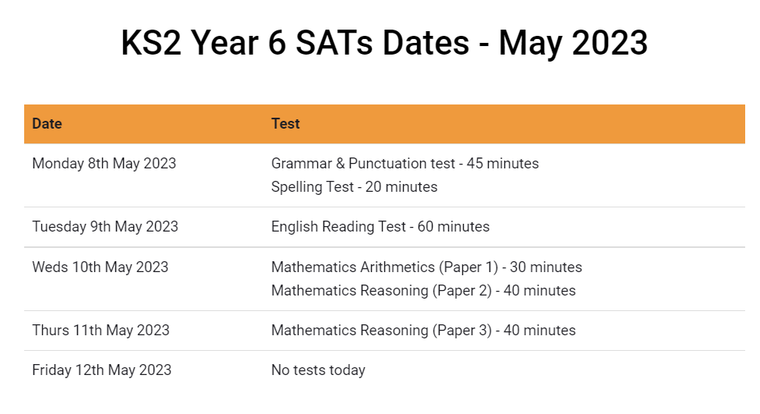
Test Timetable (yet to be confirmed by the DfE)

Slide 19
How will these test results be reported?
Your child will be given a raw score (the actual number of marks they get), alongside their scaled score and whether they have reached the national average.
Reading (1 paper) out of 50
GPS (2 papers) out of 70
Maths (3 papers) out of 110
This raw score will be converted into a scaled score. This scaled score will be reported to you in July which will indicate their achievement in each test. If your child achieves a scaled score between 100 – 110, they are working at the expected standard for Year 6. If your child achieves a scaled score above 110, they are working at a greater depth standard. This information is sent your child’s secondary school.

Slide 20

Key Stage 2 Reading
The reading test will be a single paper with questions based on three texts, which tend to increase in complexity. Your child will have one hour, which includes reading time, to complete the test.
There will be a selection of question types, including:
  Sequencing /ordering, e.g. ‘Number the events below to show the order in which they happen in the story’
  Labelling, e.g. ‘Label the text to show the introduction’
  Find and copy, e.g. ‘Find and copy one word that suggests what the weather is like in the story’
  Short constructed response, e.g. ‘What does the bear eat?’
  Open-ended response, e.g. ‘Look at the sentence that begins Once upon a time. How does the writer increase the tension throughout this paragraph? Explain fully, referring to the text in your answer.’

Slide 21
What content will be tested?
2a | 2b | 2c | 2d
Give/explain the meaning of words in context. | Retrieve and record information / identify key details from fiction and non- fiction. | Summarise main ideas from more than one paragraph. | Make inferences from the text/ explain and justify inferences with evidence from the text.
2e | 2f | 2g | 2h
Predict what may happen from details stated and implied. | Identify/explain how information/ narrative content is related and contributes to meaning as a whole. | Identify/explain how meaning is enhanced through choice of words and phrases. | Make comparisons within the text.

Slide 22

KS2 GPS
There will be two papers to test: Grammar, Punctuation and Spelling (GPVS)
-Paper 1: Grammar, Punctuation and Vocabulary (45 minutes)
-Paper 2: Spelling test
There will be a selection of question types, exploring:
Selected response, e.g. ‘Identify the adjectives in the sentence below’
Constructed response, e.g. ‘Correct/complete/rewrite the sentence below,’ or, ‘The sentence below has an apostrophe missing. Explain why it needs an apostrophe.’

Slide 23
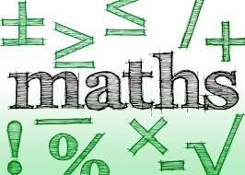
Maths
There will be three papers
-Paper 1: Arithmetic (30 minutes, 40 marks)
-Paper 2: Reasoning (40 minutes, 35 marks)
-Paper 3:Reasoning (40 minutes, 35 marks)
Total of 110 marks (raw score)

Slide 24
Common errors
Missing out the correct unit of measurement in the answer
General presentation – final answer not being clear
Correct punctuation throughout – GPS paper.
Digits not clearly formed e.g. ‘0’ looking like a ‘6’
Decimal points – missing them out or making them look like a comma or full stop
2 step problems – make sure children follow the whole question through
Recording the monetary values incorrectly e.g. must be £8.90 not £8.9
1 2 3 4 5 6 7 8 9 0

Slide 25
Your child only spends 17% of their time at school, so
How can you help at home?
Ensure your child arrives on time and with all the equipment he/she needs throughout Year 6. This will also prepare them well for secondary school.
Monitor their homework; make sure they hand it in on time. If your child has not understood what they need to do and you are unsure how best to explain, get them to ask the teacher as soon as possible.
Discuss the meaning of the text they are reading; who the characters are and any specific events in the story. Which words are unfamiliar to them? Can they think of a synonym for a word?

Slide 26
Encourage your child to go on a variety of websites to consolidate their learning. For example: KS2 Bitesize, Daily 10 and Hit the Button.
Keep practising times tables at any available time. Also practise division facts from the times tables e.g. 2x5 =10 so 10÷2= 5, then move onto decimal facts e.g 0.2x 7= 1.4.
Practise using maths in real-life situations e.g. reading timetables, money (how much change will you get?), telling the time with analogue as well as digital clocks, converting from 12 hour to 24 hour time and working out the duration of events.

Slide 27
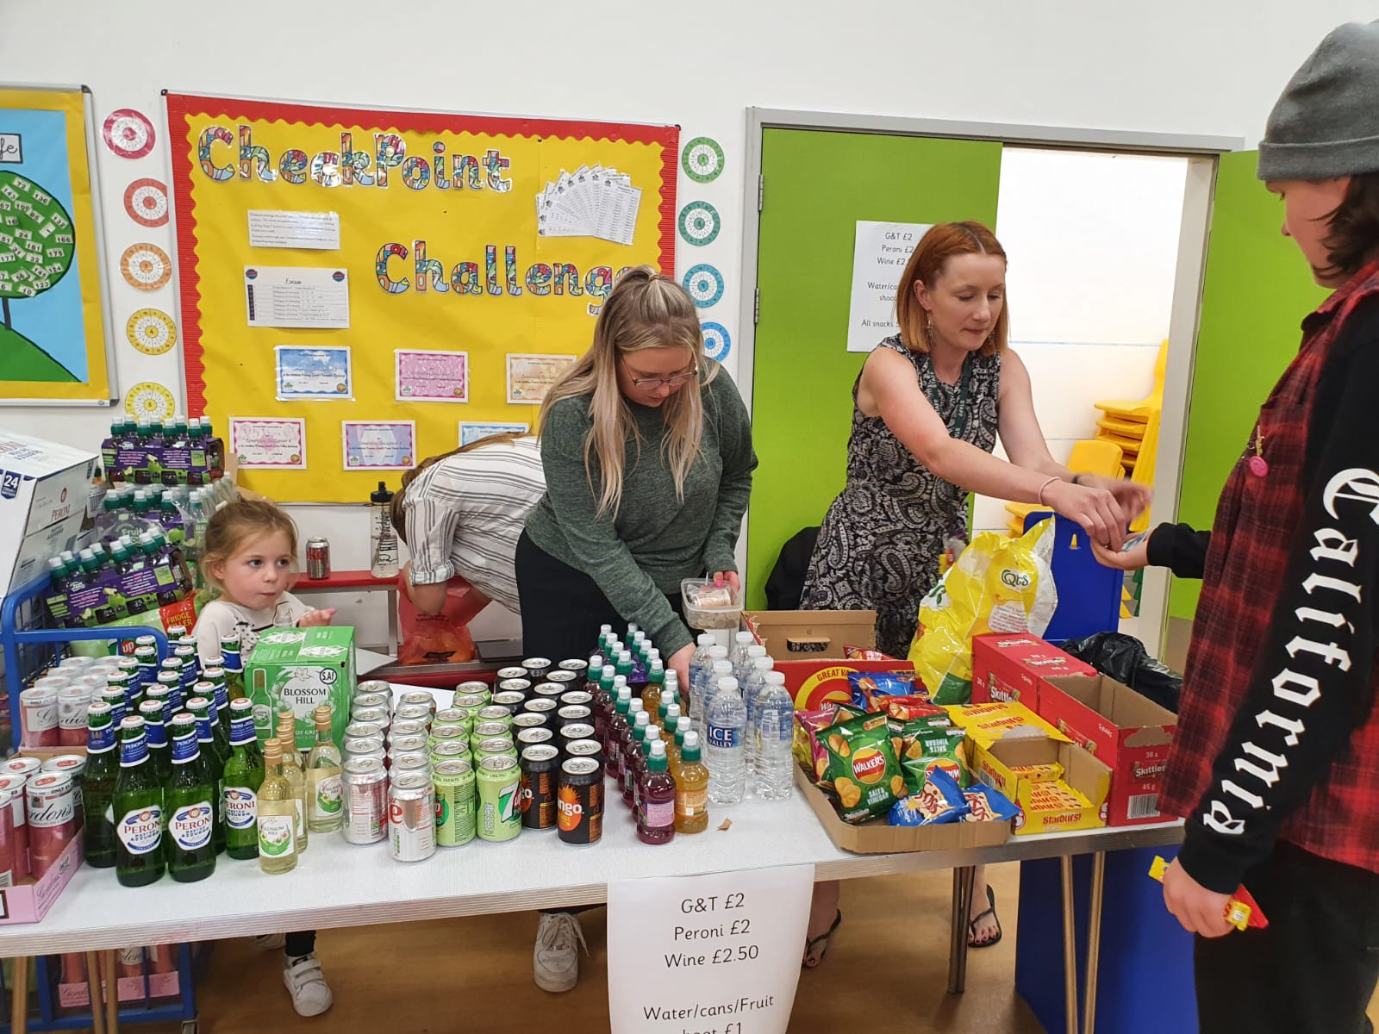

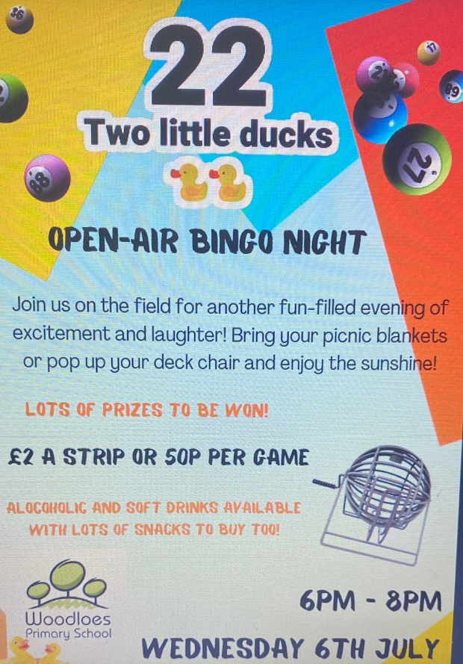
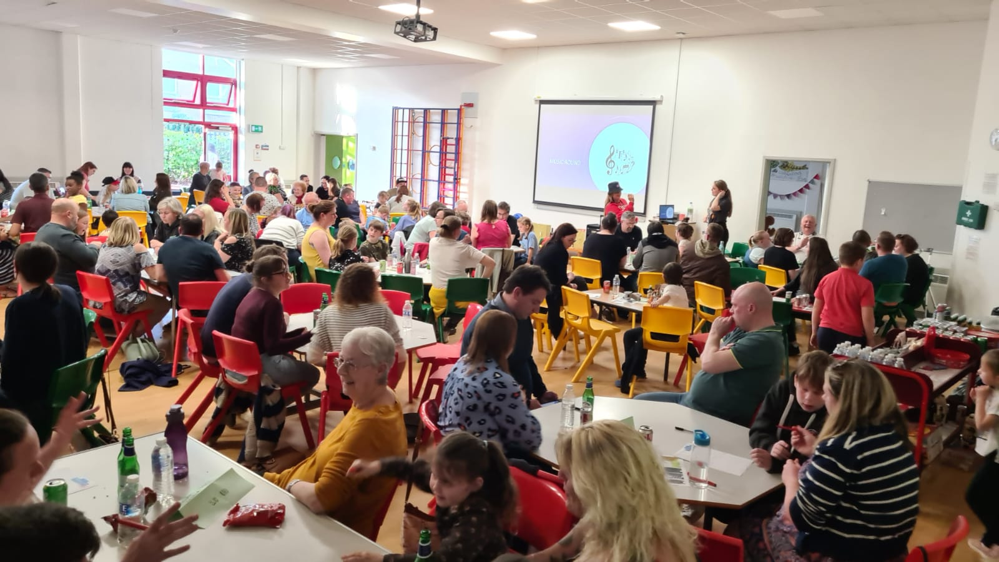
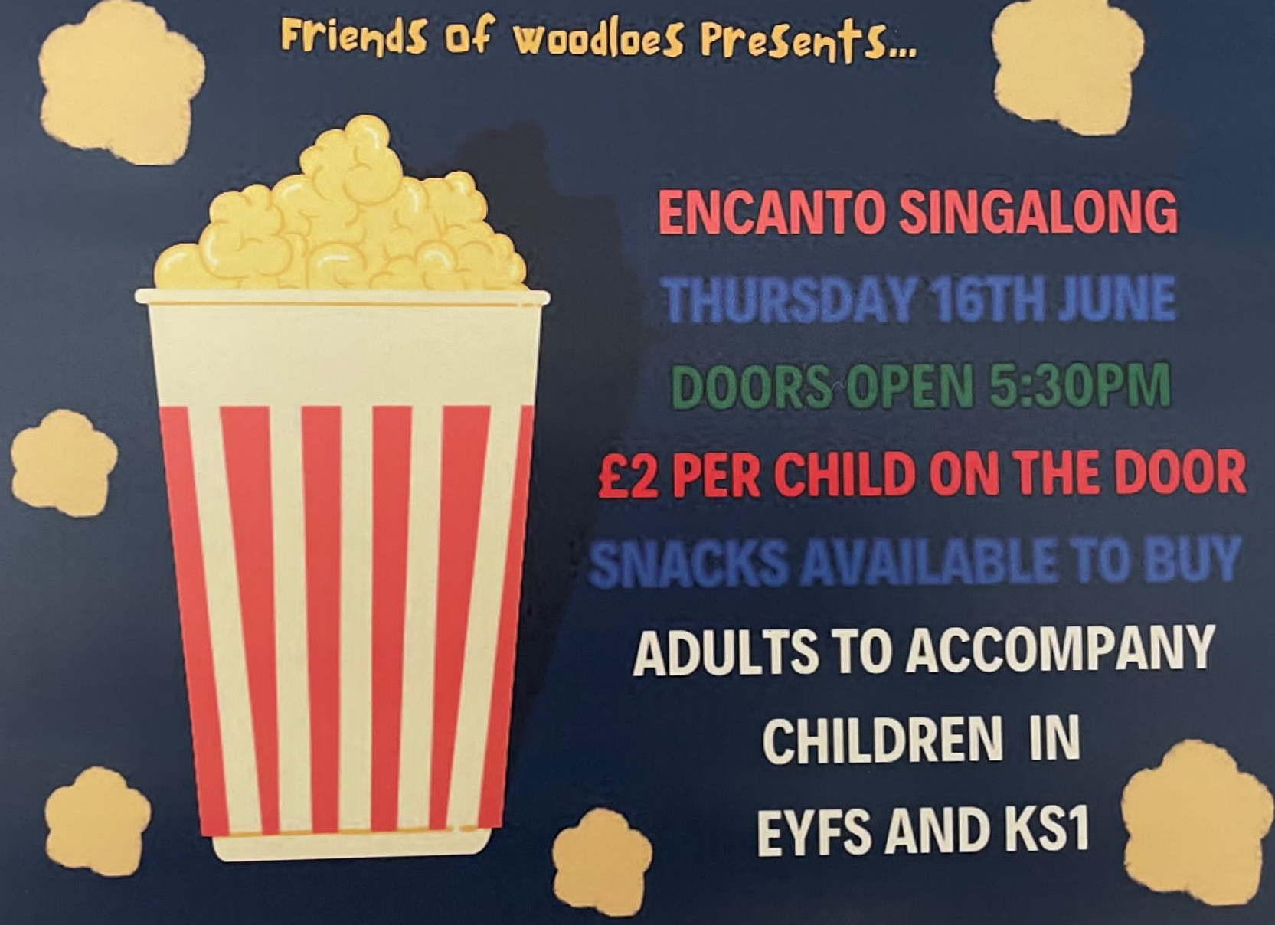
Can you volunteer and help the Friends of Woodloes PTA?
29th September
We are recruiting volunteers to support us with some of our amazing events this year and help them to run smoothly!
We’ve hosted so many great events over the year including the first Big Family Quiz, film nights and Bingo!
We managed to raise around £4000 from these and we’d like to raise even more, but we need your help.
If you’d like to join the PTA or just volunteer for any of the events please speak to Ms Valentine (Reception), Mrs Shardlow (Y1), Miss Lyons (Y2), Miss Hancox (Y2) or Miss Tresadern (Y6) or email us on friendsofwoodloes@gmail.com

Slide 28
Thank you for listening.
Any questions?
We look forward to your continuing support.
If you’d like a longer conversation, please arrange an appointment with your child’s class teacher.

