Slide 1
Staying Safe at Woodloes

Slide 2
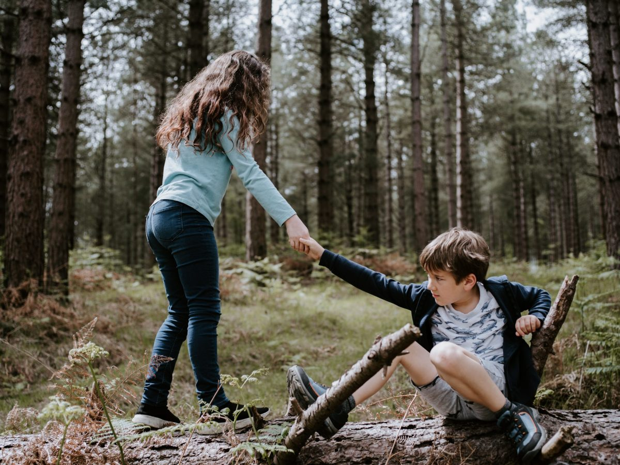
What can you see?

Slide 3
Can you think of any examples when you have helped someone or been helped by someone else at school?

Slide 4
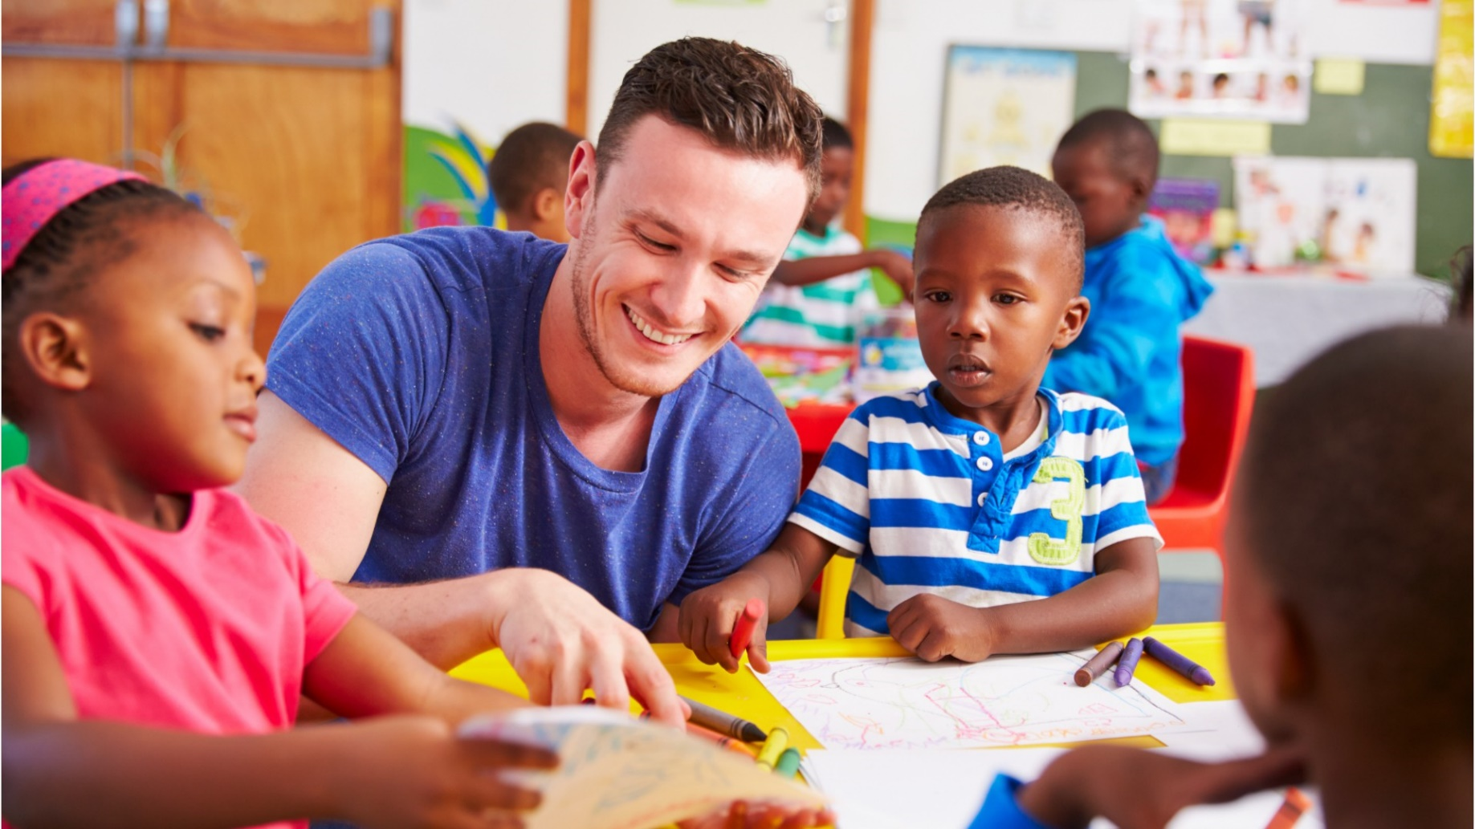
What can you see?

Slide 5
Can you think of any examples when you have been helped by an adult at school?

Slide 7
You matter…we care!

