Slide 1
Ready Respectful Safe

Slide 2
Prior learning
What has happened so far in the story?
This is based on your previous learning which you will need to apply during the lesson today.

Slide 3
Monday 20th November
LO: Predict what might happen from details stated and implied
Continue reading ‘Song of the Dolphin Boy’ from the second paragraph on page 23 - the description of Charlie on a rainy day - until page 27 . Stop reading immediately after ‘It was pure bad luck that Finn, still engrossed in the poem, happened to..’
What is Finn’s mood like?

Slide 4
What happened next…?

Slide 5
Looking for a fight, Charlie knocks Finn’s poem out of his hands and it lands in a puddle. Finn is upset and angry and can no longer hold his tongue with Charlie.
Engrossed in the poem, Finn accidently walks straight into Charlie. This causes Charlie to completely erupt! He attacks Finn and leaves him with a black eye.
What happened next…?
Charlie, looking for a fight, questions Finn about whether he will be joining the class for their swimming lessons. Charlie teases Finn when he learns Finn won’t be.
Charlie storms out of the room, slamming the door and causing the roof to vibrate so much it falls in on top of Finn.

Slide 6
Your Task
Characters
Main Event
Copyright © Teaching From Text

Slide 7
WAGOLL PLAN
Characters
Finn
In a daydream, gentle character, sad persona, lonely boy, picked on and taunted, likes to be left alone and fade into the background yet longs to have friends.
Charlie
Has a huge temper. Becomes angry very quickly, hates rainy days as he become frustrated being stuck inside each day. Has been mean and nasty to Finn in the past.
Jas
Kind to everyone. A positive person and sticks up for the underdog. Good moral compass.
Main Event
Finn daydreaming about the Selkie poem and doesn’t look where he is going.
Finn walks straight into Charlie - the straw which breaks the camel’s back.
Charlie’s anger explodes. His poem has been knocked into a puddle.
He throws Finn onto the floor and forces him to retrieve his poem from the puddle with his teeth.
Jas witnesses the disgusting behaviour and steps in.
Jas’s bravery and kindness saves Finn and scolds Charlie.

Slide 8
Where can I go for help if I’m feeling too crispy?

Slide 9
Plenary – Pupil Self Assessment
Use an emoji (at the end of your work) to show how well you understood the LO.
I fully understood the LO
I almost understand the LO but could do with some
more practise.
I did not understand the LO and need support to
understand it.

Slide 10
Ready Respectful Safe

Slide 11
Where can I go for help if I’m feeling too crispy?

Slide 12
Prior learning
What predictions did we make yesterday?
Look at your prediction plan.
This is based on your previous learning which you will need to apply during the lesson today.

Slide 13
Tuesday 2^{1st} November
LO: Include end punctuation within my inverted commas
Feature | Self Assessment
Apostrophes for singular and plural possession.
Expanded noun phrases.
Correctly punctuated direct speech.
Character description

Slide 14
Reporting clause
This adds extra information to the speech: it tells us who is speaking, provides details about the character and moves the action forward. Below are some words you might like to use in your reporting clauses depending on what mood your character is in.
Happy
replied, agreed, assured, began, commented, exclaimed, instructed, replied, stated, suggested, laughed, giggled.
complained, confessed, cried, croaked, denied, fretted, gasped, groaned, gurgled, moaned, pleaded, protested, sniffled, sobbed, stammered, uttered, wailed, whispered, worried.
argued, barked, bellowed, boasted, demanded, hissed, insisted, interrupted, jeered, ranted, raved, roared, scolded, screamed, shouted, snapped, shrieked, stormed, taunted, yelled.
nagged, lied, grumbled, blurted, babbled, grunted, mused, quavered, sneered, squealed, wondered.
Upset
Angry
Negative
Copyright © Teaching From Text

Slide 15
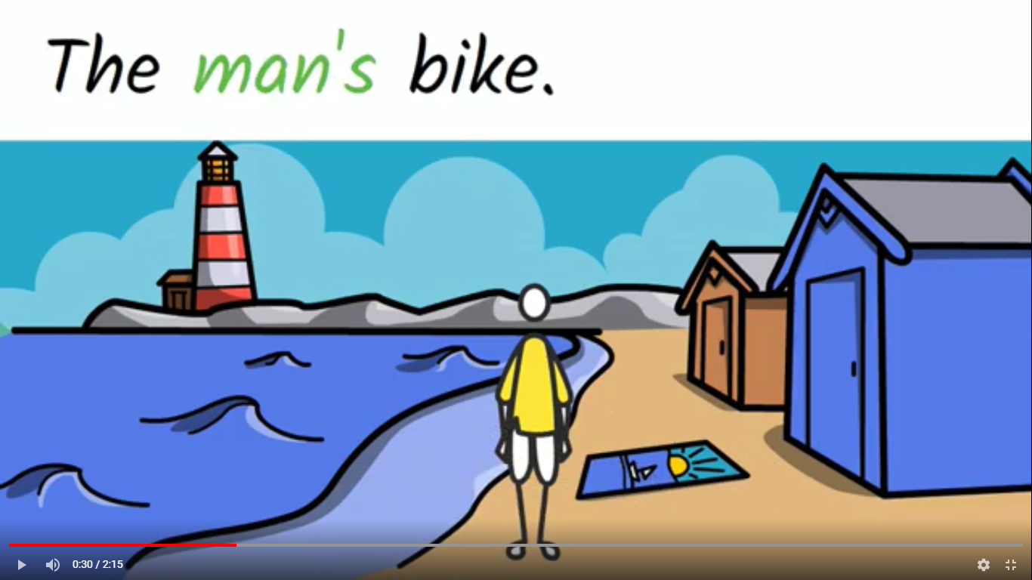
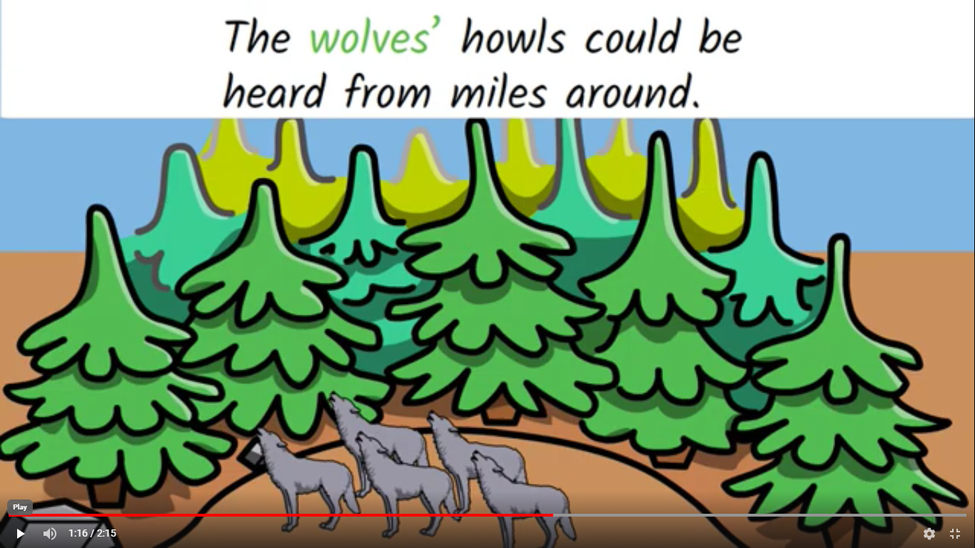
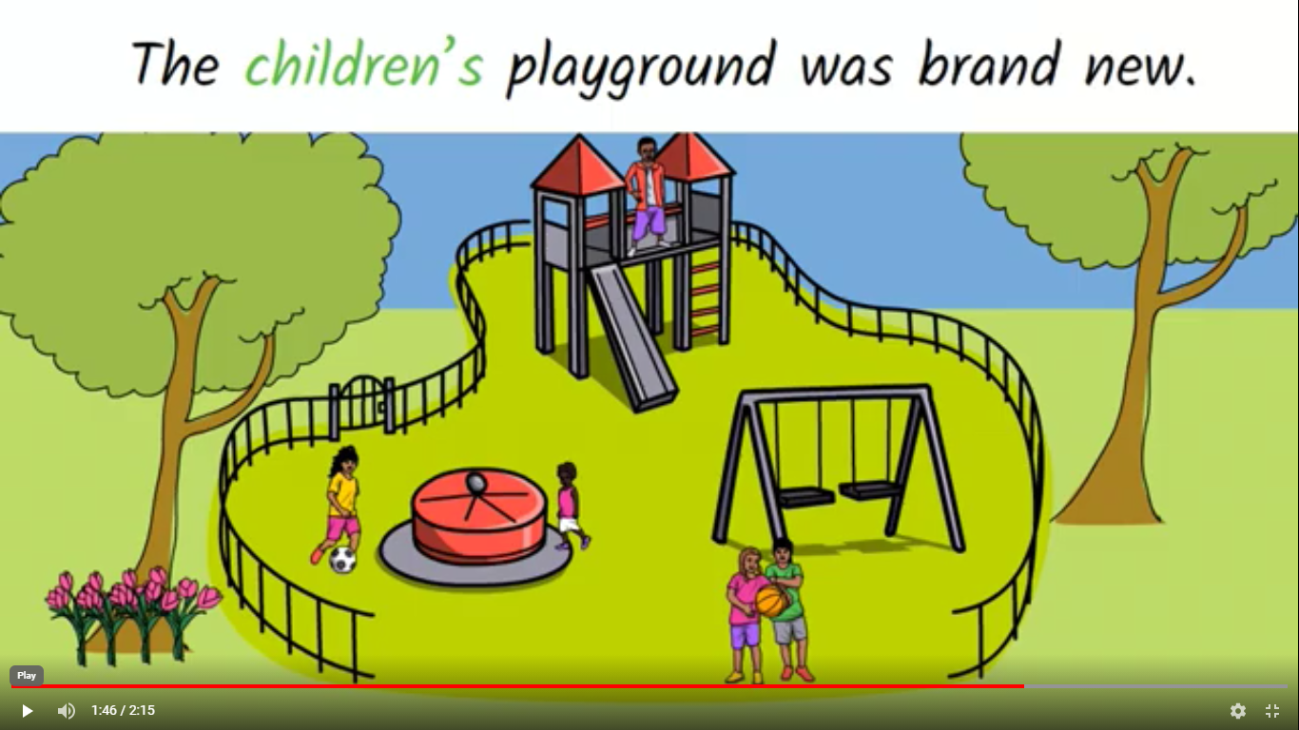
Apostrophes for possession handout
Singular possession
Plural possession
Plural noun possession
Copyright © Teaching From Text

Slide 16
WAGOLL- our alternative end of chapter
Something deep inside Finn stirred. The poem about the Selkie interested him more than anything he had ever read. On auto-pilot without looking where he was going, Finn’s naive feet carried him towards the open classroom door.
“Oi! What do you think you are doing?” Charlie reacted as Finn bumped straight into him causing Charlie to drop his poem in a puddle.
“I’m so sorry, I didn’t see you!” Finn apologised looking shocked and anxious about the repercussions.
In an instant, Charlie’s strong fist gripped Finn’s significantly grubby collar and hurled him to the floor. A look of sheer terror crossed the other children’s faces. Jas let out an audible gasp and covered her mouth with her hands.
“Pick it up!” Charlie demanded as Finn was face down looking at the poem drowning in the dirty puddle. Wanting this uncomfortable ordeal to be over, Finn crouched on his grazed hands and knees leaning forwards to retrieve the sodden poem with his right hand.
“Not with your hands, with your teeth!” Charlie taunted, spittle flying in all directions from his vicious mouth whilst stepping on Finn’s head, pressing his face into the icy water.
“Back off Charlie, that’s enough!” Jas screamed at the top of her voice, knocking Charlie’s leg out of the way with one hand and scooping Finn up with the other.
“Here’s your precious poem,” Jas scolded, slapping the soggy piece of paper against Charlie’s chest then leading Finn away in the direction of the McFees’ cottage.

Slide 17
Something deep inside Finn stirred. The poem about the Selkie interested him more than anything he had ever read. On auto-pilot without looking where he was going, Finn’s naive feet carried him towards the open classroom door.
“Oi! What do you think you are doing?” Charlie reacted as Finn bumped straight into him causing Charlie to drop his poem in a puddle.
“I’m so sorry, I didn’t see you!” Finn apologised looking shocked and anxious about the repercussions.
In an instant, Charlie’s strong fist gripped Finn’s significantly grubby collar a hurled him to the floor. A look of sheer terror crossed the other children’s faces. Jas let out an audible gasp and covered her open mouth with her hands.
“Pick it up!” Charlie demanded as Finn was face down looking at the poem drowning in the dirty puddle. Wanting this uncomfortable ordeal to be over, Finn crouched on his grazed hands and knees leaning forwards to retrieve the sodden poem with his right hand.
“Not with your hands, with your teeth!” Charlie taunted, spittle flying in all directions from his vicious mouth whilst stepping on Finn’s head: pressing his face into the icy water.
“Back off Charlie, that’s enough!” Jas screamed at the top of her voice, knocking Charlie’s leg out of the way with one hand and scooping Finn up with the other.
“Here’s your precious poem,” Jas scolded, slapping the soggy piece of paper against Charlie’s chest then leading Finn away in the direction of the McFees’ cottage.

Slide 18
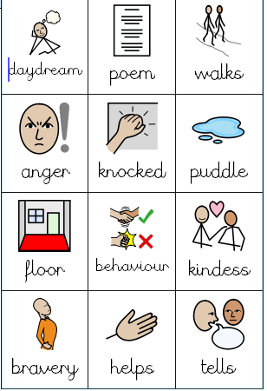

Slide 19
Plenary – Pupil Self Assessment
Use an emoji (at the end of your work) to show how well you understood the LO.
I fully understood the LO
I almost understand the LO but could do with some
more practise.
I did not understand the LO and need support to
understand it.

Slide 20
Ready Respectful Safe

Slide 21
Prior learning
Think pink your work from yesterday. Can you improve any of your sentences?
This is based on your previous learning which you will need to apply during the lesson today.

Slide 22
Day Three
LO: Include conjunctions, adverbs and prepositions to show time and cause.,
Read Chapter 3 of ‘Song of the Dolphin Boy’, pages 31 – 39.

Slide 23
What are Time Conjunctions?
Time Conjunctions tell us when something is happening: before, when, while, after, during, whilst, next, first, later, then, finally, meanwhile.
Look at these examples:
When they couldn’t find Finn, Charlie’s face turned a worrying sickly white.
Meanwhile, Jas was running ahead of the others.
Next, Kyla gasped because she knew Finn couldn’t swim.
Then Jas made a realisation, Finn must have fallen in.

Slide 24
What are Causal Conjunctions?
Causal Conjunctions links something which has happened with the cause (or reason that it happened) : because, as, since, as a result, therefore, for this reason, consequently, so.
Look at these examples:
Charlie chased Finn, consequently he may have drowned!
Jas called for Mr Munro because they needed help.
Kyla suggested Jas shouted louder since Mr Munro couldn’t hear them.
As a result, Amir kicked off his shoes ready to jump into the water.

Slide 25
Causal Conjunctions links something which has happened with the cause (or reason that it happened):
Cause is highlighted in pink and the thing which happened is highlighted in blue –
Charlie chased Finn, consequently he may have drowned!
Jas called for Mr Munro because they needed help.
Kyla suggested Jas shouted louder since Mr Munro couldn’t hear them.
As a result, Amir kicked off his shoes ready to jump into the water.
This final sentence is linked to the sentence above. The cause is Mr Munro not hearing the children, so Amir kicked off his shoes. Causal conjunctions can join phrases within a sentence, two sentences or even paragraphs.

Slide 26
Time Conjunctions
before
when
while
after
during
whilst
next
first
later
then
finally
meanwhile
Causal Conjunctions
because
as
since
as a result
therefore
consequently
for this reason
so

Slide 27
LO: Include conjunctions, adverbs and prepositions to show time and cause.
Look at each sentence below. The conjunctions are pink – identify if they are time conjunctions or cause conjunctions. Tick the correct one.
1) Amir threw off his sweater so he could jump into the water. time causal
2) Charlie offered to go in as he felt it was his fault. time causal
3) Before Charlie could move, Jas grabbed his collar. time causal
Look at each sentence below and under line the conjunction in pink. Is it time or causal?
4) Next, the children lent over the harbour wall to look at the water. time causal
5) Amir waded among the boats because he was trying to find Finn. time causal
6) Meanwhile, Kyla was shouting to find out if Amir could see him. time causal
Look at each sentence below and add in your own time or causal conjunction so it makes sense.
7) Kyla was worried that Finn may have knocked himself out ____________ of the rocks.
8) ____________ Amir reappeared out of breath.
9) Amir was reassuring ______________ the water was shallow.
10) _____________ the children just didn’t know what to do.

Slide 28
LO: Include conjunctions, adverbs and prepositions to show time and cause.
Look at the paragraph below. Each conjunction is pink, write a ‘T’ above them if they are a time conjunction or a ‘C’ above them if they are a causal conjunction.
Amir threw of his sweater because he was determined to jump into the water. Next, Charlie offered to go into the water instead as he felt it was all his fault! Before Charlie could even begin to move, Jas grabbed his collar preventing him from even taking a step! All the children rushed to look over the harbour wall as they were hoping they could see Finn. Meanwhile, Amir was wading among the boats hoping he would see Finn. During this, Kyla was shouting, asking if Amir had found him.
Look at each sentence below and add in your own time or causal conjunction so it makes sense.
2) Kyla was worried that Finn may have knocked himself out ____________ of the rocks.
3) ____________ Amir reappeared out of breath.
4) Amir was reassuring ______________ the water was shallow.
5) _____________ the children just didn’t know what to do.
Now in your book, write your own sentences; some using time conjunctions and the others using causal conjunctions. Under line the conjunctions in pink.

Slide 29
Where can I go for help if I’m feeling too crispy?

Slide 30
Plenary – Pupil Self Assessment
Use an emoji (at the end of your work) to show how well you understood the LO.
I fully understood the LO
I almost understand the LO but could do with some
more practise.
I did not understand the LO and need support to
understand it.

Slide 31
Ready Respectful Safe

Slide 32
Prior learning
What is an adverb?
This is based on your previous learning which you will need to apply during the lesson today.

Slide 33
Where can I go for help if I’m feeling too crispy?

Slide 34
Day Four
LO: Use a comma after a fronted adverbial
Read Chapter 4 of ‘Song of the Dolphin Boy’, pages 40 – 63 (as this is quite a long chapter, you may wish to read it throughout the day, rather than just in the lesson).

Slide 35
What are Adverbs of Time?
Adverbs of Time are a word or phrase which tell us when the sentence is taking place: again, early, eventually, occasionally, never, now, often, first, soon, suddenly, after, then, tonight, later, once, in the evening.
Look at these examples:
Never had Finn felt so afraid, than when Charlie chased him.
Suddenly, Finn realised he couldn’t swim!
Eventually, he was completely submerged in water.
Soon, Finn was thrashing about with his arms and legs.

Slide 36
What are Fronted Adverbials?
Fronted adverbials = the adverbs are used at the start of the sentence:
Every fronted adverbial (single word or phrase) needs a comma after it – can you place these commas into the right place?
Eventually Finn felt something brush his leg.
Then filled with joy, Finn felt he could swim.
Now Finn thought he felt a dolphin pass by.
After the dolphin was playful with his snout.

Slide 37
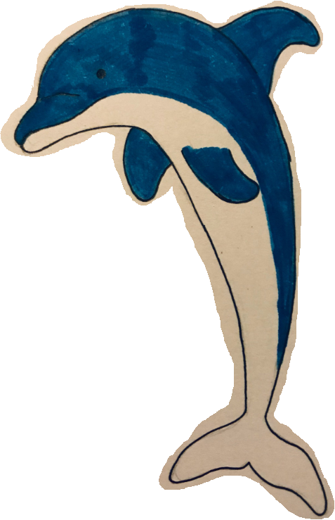
LO: Use a comma after a fronted adverbial
.
again, early, eventually, occasionally, never, now, often, first, soon, suddenly, after, then, tonight, later, once, in the evening, after lunch, during the afternoon, after that
_____________________ Finn was thrashing his limbs about in the water.
2) _____________________ he really begun to panic!
3) _____________________ Finn was able to glide in the water.
4) _____________________ a dolphin wanted to play using his snout.
5) _____________________ Finn realised that the dolphin wanted to be his friend.
6) _____________________ the dolphin wanted to leap with Finn.
7) _____________________ Finn tried to make the dolphin’s buzzing sound.

Slide 38
Plenary
What went well?
What could you improve?

Slide 39
Ready Respectful Safe

Slide 40
Prior learning
This is based on your previous learning which you will need to apply during the lesson today.

Slide 41
Where can I go for help if I’m feeling too crispy?

Slide 42
Day Five LO: Retrieve and record information from non-fiction.
Read Chapter 5 of ‘Song of a Dolphin Boy’ on pages 64 – 73.
Then return to the bottom of page 62 where Mr McFee mentions there are lots of dangers in the sea – can the children think of any?

Slide 43
LI: I can retrieve and record information from non-fiction.
In 2005, South America lost half of its Caribbean coral reefs, in just one year, to coral bleaching!
Warmer temperatures within water leads to coral bleaching. The warmer temperatures cause the corals to expel zooxanthellae (an algae living in their tissues), which leads to them turning completely white.
Coral Bleaching
The main cause behind coral bleaching is climate change. A small water temperature change – just 2 degrees Fahrenheit – can cause the coral to expel the algae. Pollution of the waters is another cause, as is too much sunlight.
When the coral turns completely white, it is known as ‘coral bleaching.’ This doesn’t kill the coral, but it causes it stress making it more likely to die. Coral is important to us as it protects the coastline by reducing the power of the waves, it provides jobs for people and is used as a source for new medicines.
Once corals die, the reef rarely comes back. As numbers of coral become more and more limited, they struggle to reproduce, and therefore, deteriorate further.
Copyright © Teaching From Text

Slide 44
LI: I can retrieve and record information from non-fiction.
Oil can spill into rivers, lakes and oceans when accidents occur with tankers, barges, pipes, drilling rigs and storage. They are caused by people making mistakes, faulty equipment, natural disasters (such as hurricanes) impacting on equipment or transport and people dumping illegally.
Oil Spills
Oil spills are harmful to marine birds, mammals, fish and shellfish. It destroys the insulation ability of marine mammals’ fur and the water-repelling abilities of birds’ feathers. Many of the animals can also ingest oil as they clean themselves, which poisons them.
Oil floats on the oceans, lakes and rivers, usually spreading out to form a thin layer. This is known as an oil slick. As this spreads and thins, it becomes sheen and often looks like a rainbow. These can sometimes be seen where cars have parked in wet weather.
Copyright © Teaching From Text

Slide 45
LI: I can retrieve and record information from non-fiction.
The nets prevent the captured marine animals from moving and cause injuries. They also stop mammals and birds from rising to the top of the water for air. Hundreds of animals can be caught with just one net.
Fishing nets can be lost or abandoned at sea and pose a threat to all types of marine life. These nets continue to trap everything they come across.
Nets
These lost and abandoned nets will continue to catch fish, but also entangle dolphins, sea turtles, porpoises, seals, sharks and other marine life. They cannot detect the nets using sight or sonar.
Nets are made of nylon or plastic which lasts for centuries and contributes to the plastic pollution in our oceans. These nets break down into smaller pieces and can be ingested by marine life leading to harm of internal organs and exposure to toxic chemicals.
Nets can cause damage to corals by entangling them making them break and leading to disease.
Copyright © Teaching From Text

Slide 46
LI: I can retrieve and record information from non-fiction.
Over-Fishing
Fishing can become an issue when vessels catch fish quicker than stocks can replenish. This is known as over-fishing.
Over-fishing has a negative impact on ocean ecosystems. It also impacts on people that rely on seafood as a main source of protein.
Additionally, to this over-fishing, fisherman can capture unwanted sea life causing losses of billions of fish, as well as sea turtles.
Copyright © Teaching From Text

Slide 47
LI: I can retrieve and record information from non-fiction.
Pollution
Pollution, found in our oceans, mainly comes from human activity. One form of pollution comes from runoff (where things have overflowed inland). These can include septic tanks, vehicles and farms.
Garbage patches are large areas of rubbish, fishing gear and marine debris that has collected. These vary in size, from tiny microplastics to very large pieces of fishing gear. They are created due to gyres: rotating ocean currents which pull debris into one central location. The patch can start at the surface of the ocean and go all the way to the ocean bed. There are five gyres globally – one in the Indian Ocean, two in the Atlantic Ocean and two in the Pacific Ocean.
Marine debris, which consists of tiny pieces of microplastics, abandoned fishing gear and derelict vessels, is also a problem. Marine species can be seriously harmed by being entangled or through ingestion.
Copyright © Teaching From Text

Slide 48
LI: I can retrieve and record information from non-fiction.
Nets
Coral Bleaching
Pollution
In my opinion, the most worrying ‘danger’ to the sea is…
Oil Spills
Over-Fishing
Copyright © Teaching From Text

Slide 49
Plenary
Can you summarise the story so far?

