Slide 1
Welcome to the Year 6 Arithmetic Methods Session

Slide 2
Addition of whole numbers -Column Method Q1

Slide 3
Subtraction of whole numbers -Column Method Q2

Slide 4
Addition and subtraction of decimal numbers - Column Method Q2&3

Slide 5
Understanding the place value within addition (partitioning) Q5

Slide 6
Multiplication of two numbers -long multiplication method

Slide 7
Multiplication of two numbers - long multiplication method Q6

Slide 8
Multiplying and dividing by 10, 100 and 1000 -movement of digits Q7 & 8

Slide 9
Division of a number using short division Q9

Slide 10
Division of a number giving a decimal answer (short division) Q10

Slide 11
Division of a number by a 2-digit number - long division

Slide 12
Division of a number by a 2-digit number - long division Q11

Slide 13
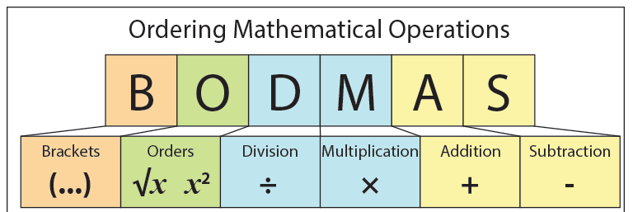
Q12

Slide 14
Find a percentage of an amount Q13

Slide 15
Find a fraction of a quantity Q14

Slide 16
Add and subtract fractions with the same denominator Q15 & 16

Slide 17
Add and subtract fractions with different denominators Q17 & 18

Slide 18
Add and subtract mixed number fractions Q19 & 20

Slide 19
Multiply fractions Multiply the numerator and the denominator Q21

Slide 20
Multiplication of a mixed number by a whole number Q22
** Some children may find it easier (dependent on the question) to find 1 lot of the number (e.g. 1 x 57 = 57) and then ½ of the number (e.g. ½ x 57 = 28.5). Finally, add the two totals together (e.g. 57 + 28.5 = 85.5)

Slide 21
Multiply a fraction by an integer Q23

Slide 22
Divide a fraction by an integer Q24

