Slide 1
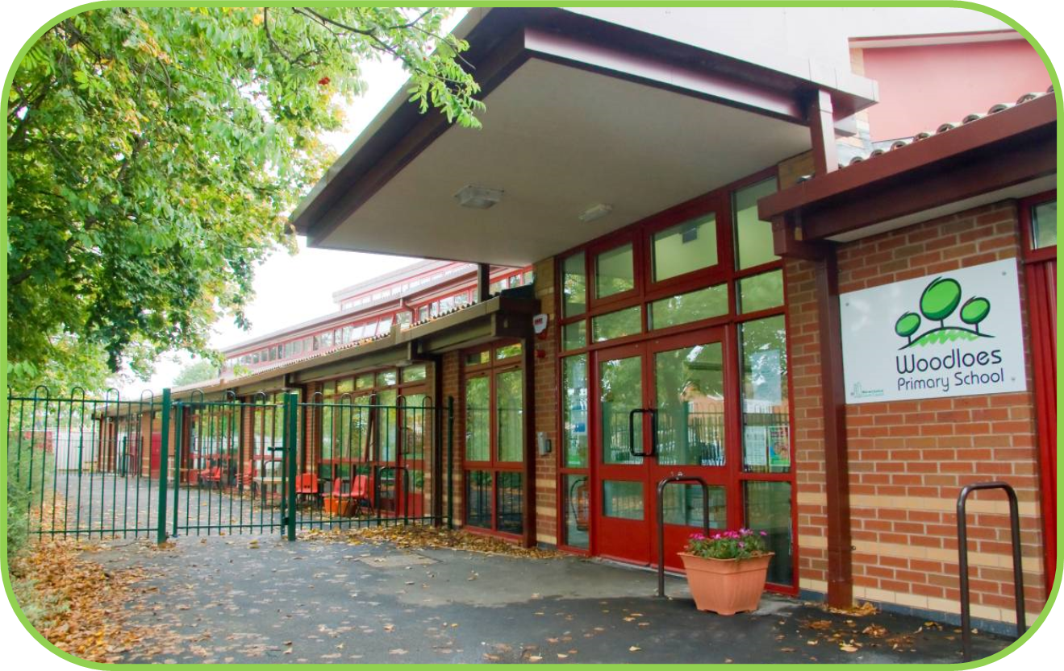
Welcome to the Reception Curriculum Meeting

Slide 2
What we will cover for you tonight:
What is the Early Years Foundation Stage and it’s curriculum?
To find out how the reception unit works
What is Jolly Phonics?
To understand how you can support your child at home

Slide 3
The Early Years Foundation Stage Curriculum
Was revised 2020 but still based on 7 areas of learning
Three prime areas
Personal, Social and Emotional Development
Communication and Language
Physical Development
Four specific areas
Literacy
Maths
Understanding the World
Expressive Arts and Design
Develop curiosity and enthusiasm for learning
Crucial in order to develop skills in the specific areas

Slide 4
How we teach
Through our environment and following the children’s interests child led learning
Continuous Provision - sand, water, creative area etc
Enhanced Provision – what we put in those areas to engage the children and focus their learning
Short teacher led input sessions – phonics and maths initially

Slide 5
The Early Years Foundation Stage Curriculum (EYFS)
There are 17 areas of the EYFS curriculum.
They are the17 Early Learning Goals the children are expected to achieve at the end of the Reception year.
This will show Good Levels of Development (GLD) this is reported to parents/carers in the end of year report.

Slide 6
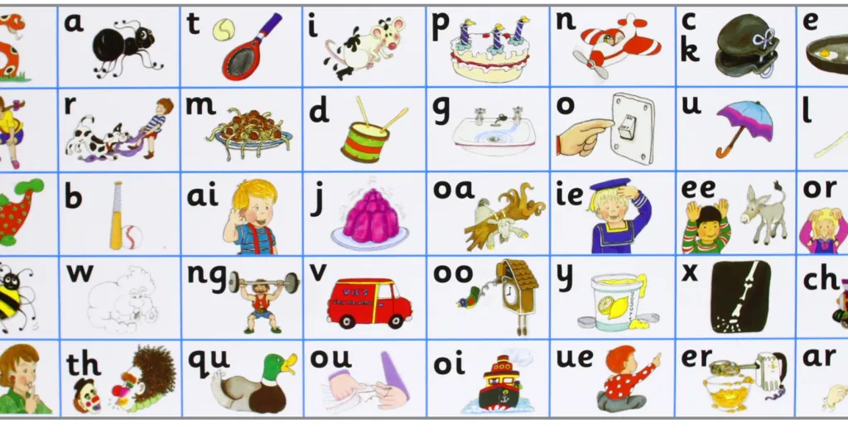
Phonics
Jolly Phonics
A validated synthetic phonics scheme that teaches through stories, song, actions and characters.

Slide 7
Jolly Phonics
Children learn to read and write through a validated programme called Jolly Phonics
Learn the 42 sounds of English
The first term will be spent learning the letter sounds and names.
One letter sound is taught each day.
https://www.youtube.com/watch?v=-ksblMiliA8 link to correct pronunciation
s, a, t, i, p, n
c k, e, h, r, m, d
g, o, u, l, f, b
ai, j, oa, ie, ee, or
z, w, ng, v, oo, oo
y, x, ch, sh, th, th
qu, ou, oi, ue, er, ar

Slide 8

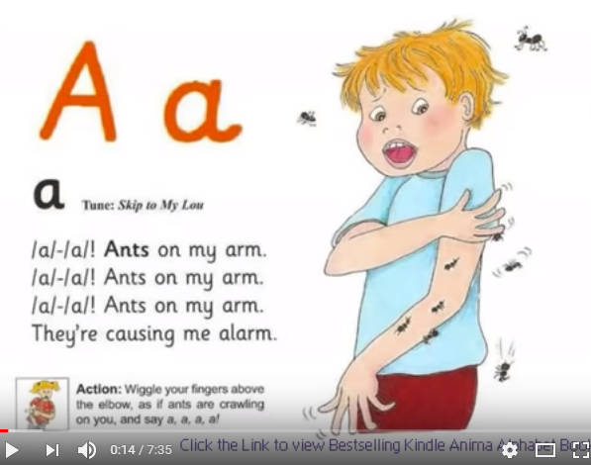
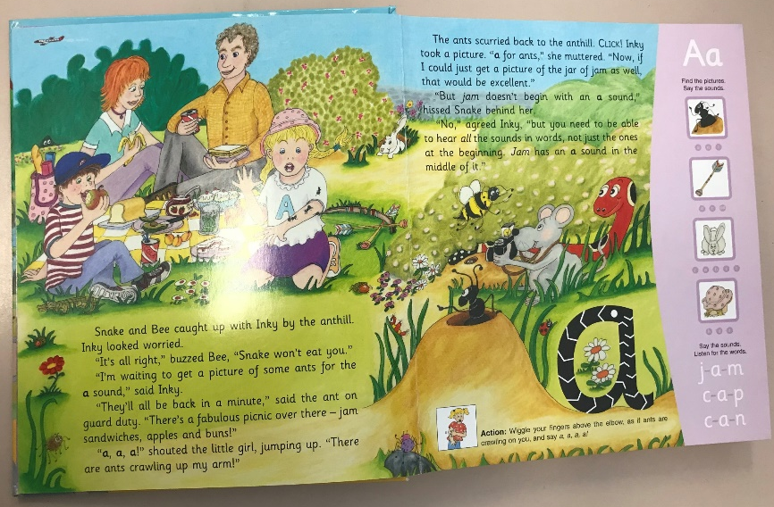
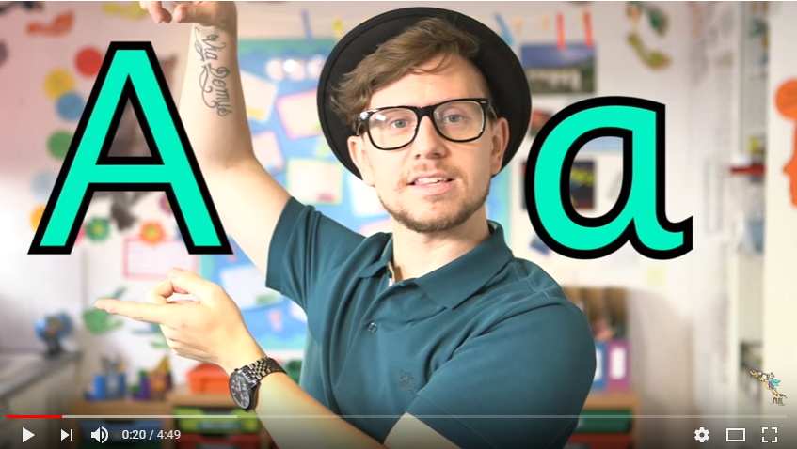
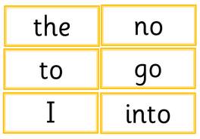
Revisit
Letter formation
S
Song
Teach
a
Story and action
Mr Thorne does phonics
Tricky words

Slide 9
Start with singular sounds
Progress onto digraphs
Digraphs are where two letters make one sound e.g. ‘sh’ or ‘ch’
The ‘oo’ and ‘th’ digraphs are initially introduced in two sizes. The children learn that they each make two different sounds, as in ‘book’ and ‘moon’

Slide 10
In order to read using phonics children need to blend sounds for reading
Most words can be broken down into individual sounds.
e.g.
c a t
If a word has a digraph in it then it is blended like this:
s h i p

Slide 11
Segmenting for spelling
Segmenting is separating a word into its original sounds
e.g.
d o g
To help with segmenting, we use robot arms.

Slide 12
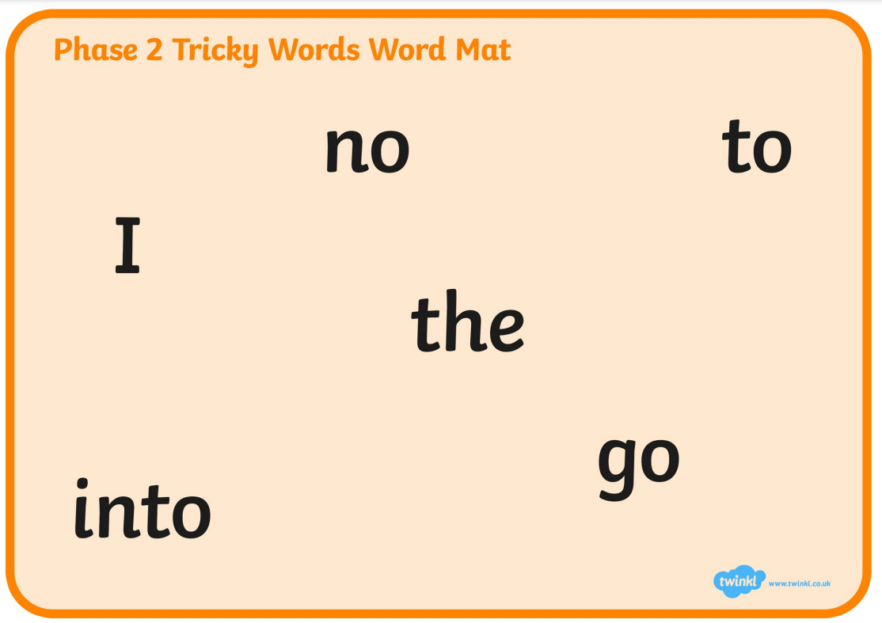
Tricky words
Some words cannot be sounded out by reading the sounds.
the
she
my

Slide 13
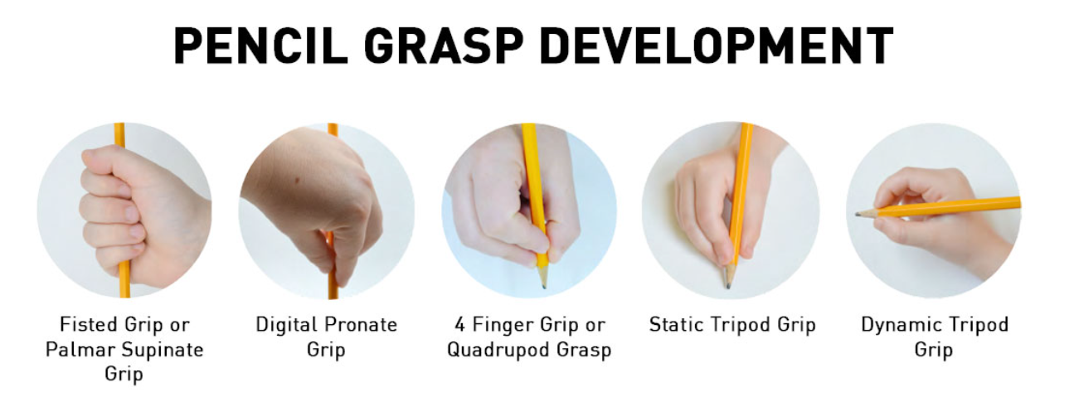
Letter formation

Slide 14
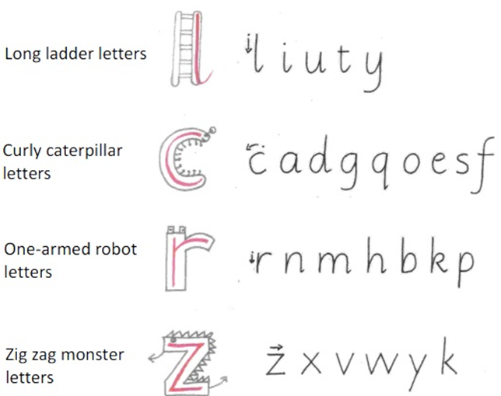

Slide 15
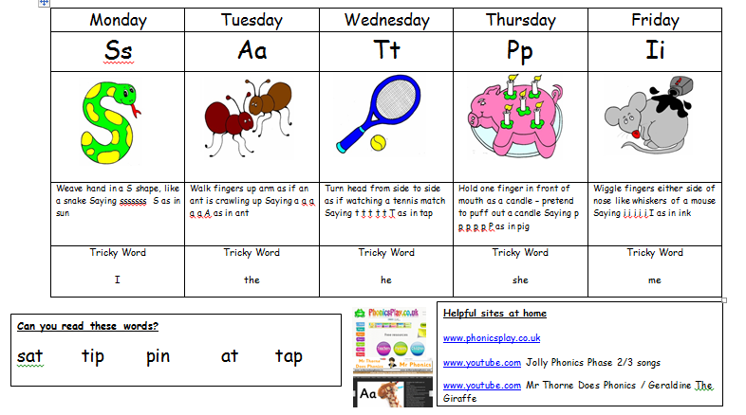
We will send by email, a weekly sheet, including sounds, jolly phonic actions and tricky words to your child practise so you can support your child’s learning.

Slide 16


What you can do at home
Practise sounds
Read as often as possible (3/4 times a week)
- Record reading in the reading record book
-Books are in the classroom for children to change and on Bug Club
-Active Learn Bug Club login (login will be in reading diary) to access online books (login – my stuff – open books)

Slide 17
What you can do at home
Practise writing their name, encouraging correct pencil grip and letter formation
Practise blending and segmenting orally as well as for reading and writing
Practise reading and spelling tricky words
Helpful tips for writing at home:
Write shopping lists
Write letters to family members or fictional characters e.g. the tooth fairy
Write cards
Chalks/water paintbrushes

Slide 18
Finally …
At home, remember little and often!
Your child may be tired after school but don’t worry. It’s better to leave it, than to push too hard.
Remember, effort on your part, at this stage, is worth it.

Slide 19


Maths

Slide 20
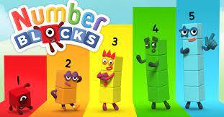
Following recent reports of number success from our academy and local consortium we are teaching number initially following NCTEM which use Number blocks.

Slide 21
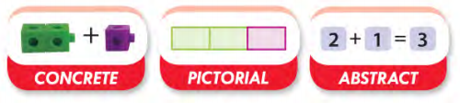
My Mastery Focus
Represent concepts using objects and pictures
Reaches out to a variety of learners
Concrete allows discovery
Pictorial allows conceptual understanding
Abstract allows a shorted and more efficient way to represent numerical ideas using symbols.

Slide 22
My Mastery focuses on the premise of ‘depth before breadth’.
Children may be secure in recognising, representing and counting to 20, but this math scheme encourages embedding this learning before moving on to higher numbers. This allows a focus on number representation and developing language skills before learning a new concept.

Slide 23
What does a Maths lesson look like?
Maths meetings every morning – days of the week, months, weather, number of children.
New learning (big picture, star words, using full sentences, model talk task).
Talk task (working in pairs with manipulatives to investigate new learning).
Resources in the environment.
This keeps the lesson pacey, gives flow and allows more opportunities to teach creatively, give feedback and assess learning.
Pupils have access to plenty of concrete materials such as bead strings and place value counters so that they have time to fully explore mathematics.

Slide 24
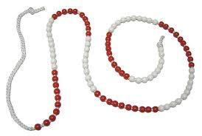


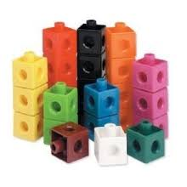
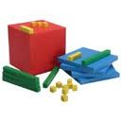
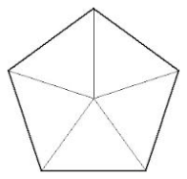

What do concrete resources look like?
Bead strings
Bar models
100 grids
Number lines
Shapes
Dienes blocks
Multilink cubes
Notes:
These are some examples of materials that can be used at the “concrete” and “pictorial” stages to support students at all levels of attainment to access mathematics and deepen their understanding.

Slide 25
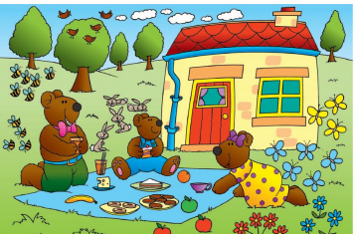
Big Pictures
Sometimes we will use a ‘Big Picture’. This provides opportunities to:
engage children
relate maths to real life applications
Make connections
Promote and develop pupil reasoning
“3 bears”
“There are three bears in the picture”
“I can see 3 yellow butterflies and 5 blue butterflies. There are 8 butterflies all together.”

Slide 26
How can I become involved?
Talk to your child about their learning, what they learn in their maths lessons each day.
Discuss numbers all around you: door numbers, bus numbers etc.
Encourage your child to predict what number will come next in a sequence of door numbers – are they odd or even?
Cooking and shopping with your child, getting them to weigh ingredients, using language such as “more” and “less/fewer”. Talk about full half full and empty.
Encourage your child to talk in ‘full sentences’.

Slide 27
Thank you for listening.
Any questions?

